Slide 1
Search project
CS616

Slide 2
Browser-based personalization
Export your own browser history from Chrome
Instructions
Copy the sqllite3.exe file I’ve given you into your working folder
Copy the ‘History’ file from your local Chrome cache into the same folder
At the command prompt, enter the following line
sqlite History "select datetime(last_visit_time/1000000-11644473600,'unixepoch'),url from urls order by last_visit_time desc" > history_export.txt
You should have your history exported to a text file in the same folder now.

Slide 3
Baseline code
You’ll find it zipped up on the webpage
Finds URL → Domain mapping
Processes domain names and meta-data as text to construct a document corpus
Runs a topic model on unique documents seen in the corpus
Shows basic results

Slide 4
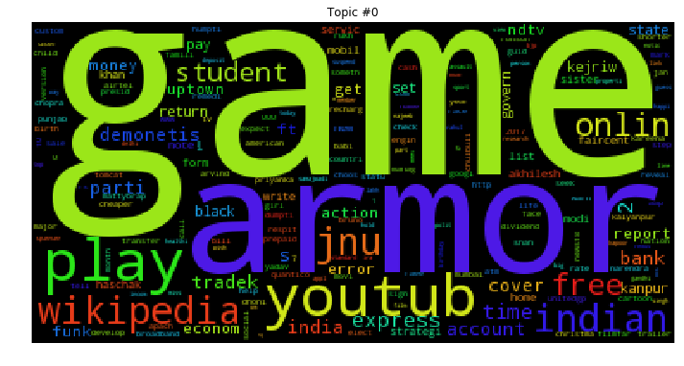
Sample topics

Slide 5
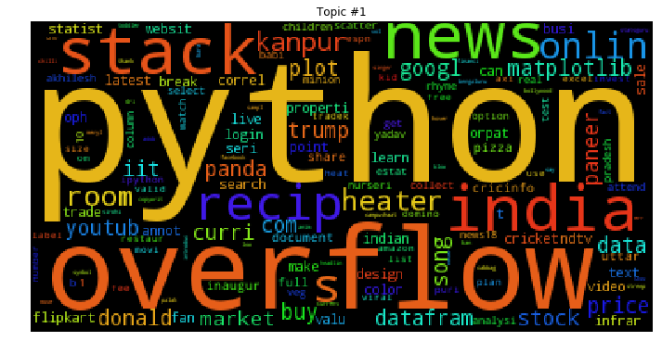
Sample topics

Slide 6

Sample topics

Slide 7
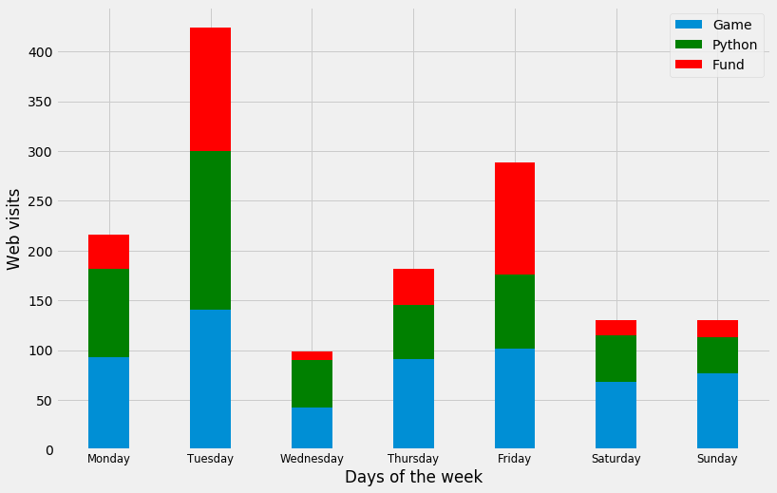
Elementary counts analysis

Slide 8
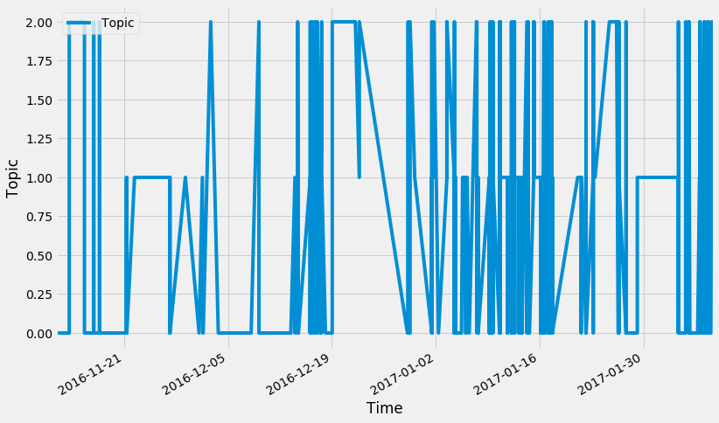
Elementary temporal analysis

Slide 9
Possibilities
Option 1: Extend counts analysis to hours within the day
Instead of days within week I showed here
Generate within-day predictions for which topics are likely to be viewed in the coming hour
***
Option 2: Identify transition points within browsing history
Dig into the LDA code, or your favorite clustering algorithm’s code, to probabilistically characterize the location of the user within the topic at the time of a transition
Bonus points for using dwell time as a marker
***(*)
Option 3: Predict topic transitions (at whatever time-scale)
Use HMMs to estimate transition probability as a function of hidden latent parameters, estimated via temporal and learned TP characteristics
***(*)
Option 4: Make personalized recommendations
Build on option 2 or option 3 to generate personalized recommendations
*****

Slide 10
More information
Deadline is Aug 20th
Feel free to come to me if you get stuck
Optional deadline to tell me what you’re doing Aug 13th
Use python – it will make your like easier
My setup: Anaconda
Extra packages needed for this project
Stop_words
Gensim
NLTK
Can install easily from conda command line

